Slide 1
Qualitätssicherung von Software
Prof. Dr. Holger Schlingloff
Humboldt-Universität zu Berlin
und
Fraunhofer FIRST

Slide 2
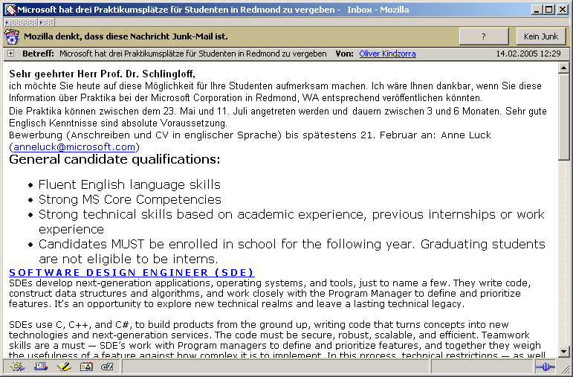
Ein Hinweis von Microsoft

Slide 3


SPICE (ISO 15504)
SPICE: Software Process Improvement Capability Determination
SPICE ist ein Projekt der ISO zur Entwicklung eines Standards für Software Process Assessments
  erstmals 1998 als technischer Bericht publiziert
  Standard aktuell überarbeitet: ISO IEC 15504:2003 (Juli 2003)
Dokumente
  http://www.sqi.gu.edu.au/spice/
  http://www.isospice.com
Zielsetzung: Umfassender Rahmen, Integration verschiedener vorhandener Ansätze (ISO, CMM, Bootstrap, …)
  Stark an CMM angelehnt
  Bewertung von Prozessen, nicht von Organisationen

Slide 4
Charakteristika von SPICE
Abdeckung einer weiten Spanne von SW-Organisationen und Anwendungen
Referenzmodell
Vergleichbarkeit, Wiederholbarkeit, Objektivität
keine weiteren Voraussetzungen
praktische Durchführbarkeit, Effizienz
„can be used by organizations involved in planning, managing, monitoring, controlling and improving the acquisition, supply, development, operation, evolution and support of software“
Aspekte
  Bewertung (Assessment),
  Verbesserung (Improvement)
  Beurteilung (Determination)

Slide 5
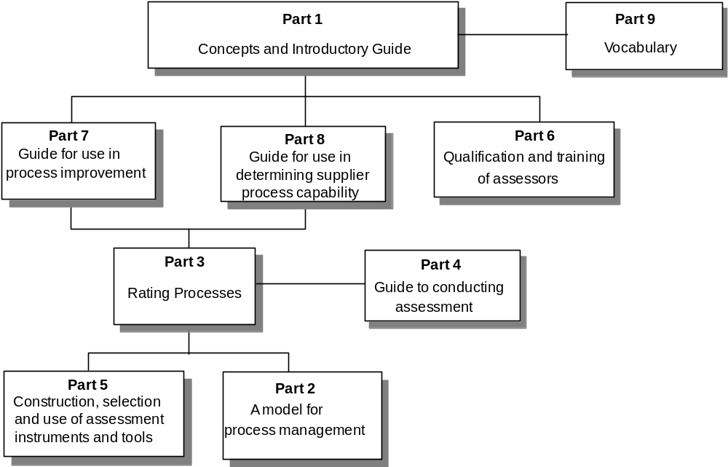
Dokumente im Standard
Standard
  Part 1: Concepts and
  introductory guide
  Part 2: A reference model
  for processes and
  process capability
  Part 3: Performing
  an assessment
  Part 4: Guide to
  performing assessments
  Part 5: An assessment model
  and indicator guidance
  Part 6: Guide to
  competency of assessors
  Part 7: Guide for use in
  process improvement
  Part 8: Guide for use in
  determining supplier
  process capability
  Part 9: Vocabulary
Nur wenige normative Teile (2,3,5), sonst Leitfäden

Slide 6
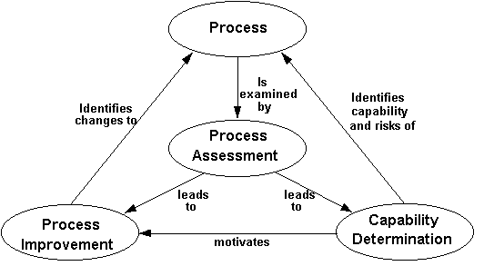
Struktur des Modells

Slide 7
Prozess-Kategorien
Process category | Brief description
Customer-Supplier | Processes that directly impact the customer
Engineering | Processes that specify, implement, or maintain a system and software product
Project | Processes that establish the project, and co-ordinate and manage its resources
Support | Processes that enable and support the performance of the other processes on the project
Organization | Processes that establish the business goals of the organi-zation and develop process, product, and resource assets which will help the organization achieve its business goals
> 200 einzelne Prozesse in diesen Kategorien, die bewertet werden

Slide 8
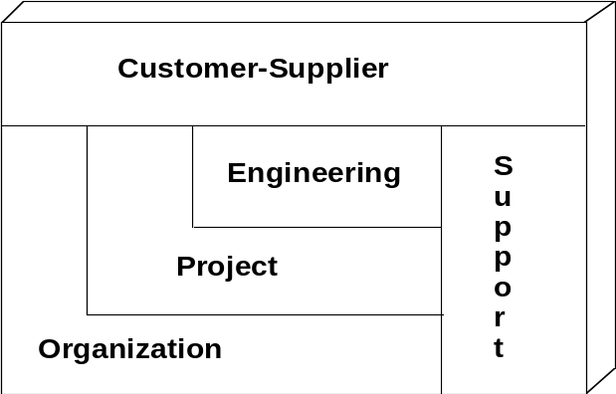
Prozesse Kundenkategorie
CUS.1 Acquire software product and/or service
  CUS.1.1 Identify the need
  CUS.1.2 Define the requirements
  CUS.1.3 Prepare acquisition strategy
  CUS.1.4 Prepare request for proposal
  CUS.1.5 Select software product supplier
CUS.2 Establish contract
  CUS.2.1 Review before contract finalization
  CUS.2.2 Negotiate contract
  CUS.2.3 Determine interfaces to independent agents
  CUS.2.4 Determine interfaces to subcontractors
CUS.3 Identify customer needs
  CUS.3.1 Obtain customer requirements and requests
  CUS.3.2 Understand customer expectations
  CUS.3.3 Keep customers informed
CUS.4 Perform joint audits and reviews
  …
CUS.5 Package, deliver, and install the software
CUS.6 Support operation of software
CUS.7 Provide customer service
CUS.8 Assess customer satisfaction

Slide 9
Prozesse Entwicklungskategorie
ENG.1 Develop system requirements and design
ENG.2 Develop software requirements
ENG.3 Develop software design
ENG.4 Implement software design
ENG.5 Integrate and test software
ENG.6 Integrate and test system
ENG.7 Maintain system and software
ENG.1.1 Specify system requirements. Determine the required functions and capabilities of the system and document in a system requirements specification.
  Note: the system requirements specification describes such things as
  – functions and capabilities of the system;
  – performance of the system;
  – safety;
  – reliability;
  – security;
  – human engineering;
  – interface;
  – operations, and maintenance requirements;
  – design constraints and qualification requirements.
  See CUS.3 for discussion of customer requirements used as an input to system requirements analysis.

Slide 10
Prozesse Projektkategorie
PRO.1 Plan project life cycle
PRO.2 Establish project plan
PRO.3 Build project teams
PRO.4 Manage requirements
PRO.5 Manage quality
PRO.6 Manage risks
PRO.7 Manage resources and schedule
PRO.8 Manage subcontractors
Beispiel:
  PRO.5.1 Establish quality goals. Based on the customer's requirements for quality, establish quality goals for various checkpoints within the project's software life cycle.
  PRO.5.2 Define quality metrics. Define metrics that measure the results of project activities to help assess whether the relevant quality goals have been achieved.
  PRO.5.3 Identify quality activities. For each quality goal, identify activities which will help achieve that quality goal and integrate these activities into the software life cycle model.
  PRO.5.4 Perform quality activities. Perform the identified quality activities.
  PRO.5.5 Assess quality. At the identified checkpoints within the project's software life cycle, apply the defined quality metrics to assess whether the relevant quality goals have been achieved.
  PRO.5.6 Take corrective action. When quality goals are not achieved, take corrective action.

Slide 11
Prozesse Unterstützungs- und Organisationskategorie
SUP.1 Develop documentation
SUP.2 Perform configuration management
SUP.3 Perform quality assurance
SUP.4 Perform problem resolution
SUP.5 Perform peer reviews
ORG.1 Engineer the business
ORG.2 Define the process
ORG.3 Improve the process
ORG.4 Perform training
ORG.5 Enable reuse
ORG.6 Provide software engineering environment
ORG.7 Provide work facilities

Slide 12
Varianten und Erweiterungen
Der Standard stellt ein Metamodell für die Bildung von Varianten zur Verfügung
  Erweiterungen dürfen die Basis nicht beeinträchtigen
  Varianten sind ausgewählte wohldefinierte Teilmengen
  Rückverfolgbarkeit, Dokumentation, Abhängigkeiten

Slide 13
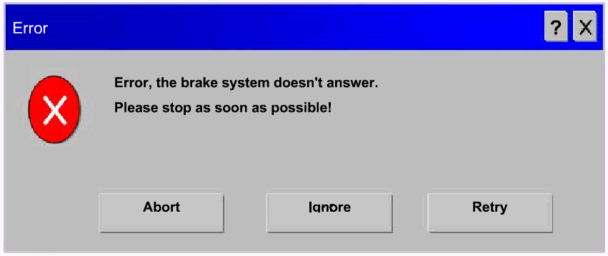
Pause!

Slide 14
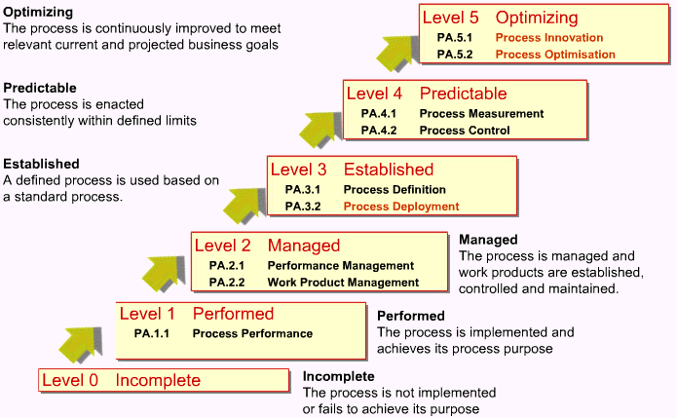
Reifegrade
Unterschied zu CMM? Wieso?
http://www.q-labs.de/images/user/Management_SW_Lieferanten_VW.pdf
Notes:
Initial-Wiederholbar-Definiert-Beherrscht -Optimierend

Slide 15
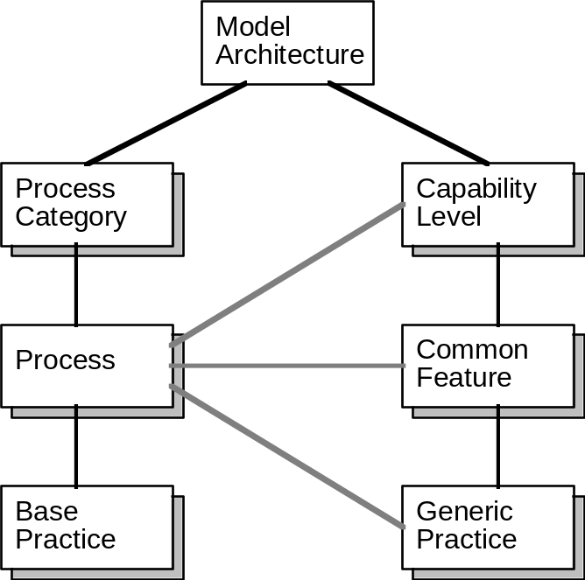
Modellarchitektur
Jeder Prozess gehört zu einer Kategorie und definiert bestimmte Praktiken
Prozesse werden eingeteilt in Reifegrade (capability levels) auf Grund der Erfüllung von gemeinsamen Merkmalen
Gemeinsame Merkmale (common features) sind Gruppen von Praktiken, die einen Aspekt der Prozessimplementierung umfassen
Jedes gemeinsame Merkmal basiert auf generischen Praktiken für dieses Merkmal

Slide 16
Gemeinsame Merkmale (1)
Level 1: Performed-Informally Level
  Common Feature 1.1: Performing Base Practices
    1.1.1 Perform the process.
Level 2: Planned-and-Tracked Level
  Common Feature 2.1: Planning Performance
    2.1.1 Allocate resources. 2.1.4 Provide tools.
    2.1.2 Assign responsibilities. 2.1.5 Ensure training.
    2.1.3 Document the process. 2.1.6 Plan the process.
  Common Feature 2.2: Disciplined Performance
    2.2.1 Use plans, standards, and procedures.
    2.2.2 Do configuration management.
  Common Feature 2.3: Verifying Performance
    2.3.1 Verify process compliance.
    2.3.2 Audit work products.
  Common Feature 2.4: Tracking Performance
    2.4.1 Track with measurement.
    2.4.2 Take corrective action.

Slide 17
Gemeinsame Merkmale (2)
Level 3: Well-Defined Level
  Common Feature 3.1: Defining a Standard Process
    3.1.1 Standardize the process.
    3.1.2 Tailor the standard process.
  Common Feature 3.2: Performing the Defined Process
    3.2.1 Use a well-defined process.
    3.2.2 Perform peer reviews.
    3.2.3 Use well-defined data.
Level 4: Quantitatively-Controlled Level
  Common Feature 4.1: Establishing Measurable Quality Goals
    4.1.1 Establish quality goals.
  Common Feature 4.2: Objectively Managing Performance
    4.2.1 Determine process capability.
    4.2.2 Use process capability.
Level 5: Continuously-Improving Level
  Common Feature 5.1: Improving Organizational Capability
    5.1.1 Establish process effectiveness goals.
    5.1.2 Continuously improve the standard process.
  Common Feature 5.2: Improving Process Effectiveness
    5.2.1 Perform causal analysis.
    5.2.2 Eliminate defect causes.
    5.2.3 Continuously improve the defined process.

Slide 18
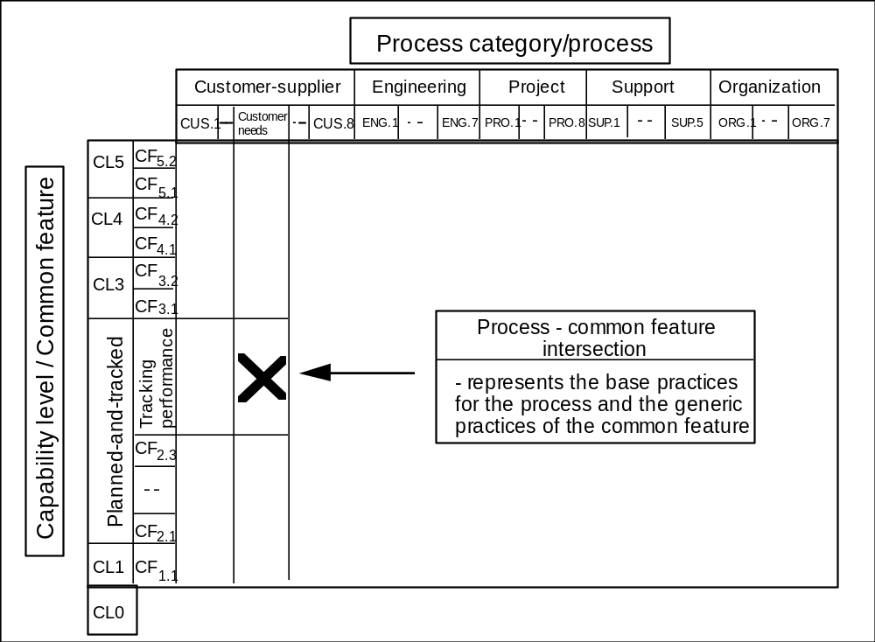
2D-Architektur von SPICE

Slide 19
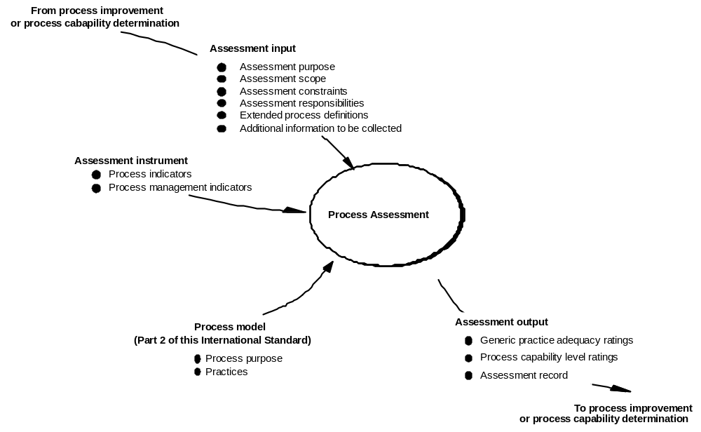


Prozessbewertungen (Assessments)

Slide 20
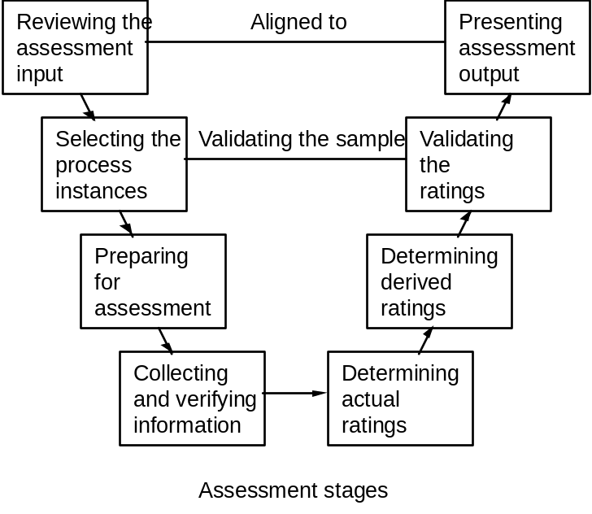
Durchführung von Assessments
Definition der Eingabedokumente
Festlegung von Verantwortlichkeiten
Bewertung von Prozessinstanzen
  Beurteilung der Basispraktiken
    vorhanden, angemessen?
  Angemessenheit der generischen Praktiken
    nicht angemessen, teilweise angemessen,
    weitgehend angemessen, vollständig angemessen
  Beurteilung der Gesamtprozessreife
    Gleichgewichtung der generischen Praktiken!
Dokumentation der Ergebnisse
  sämtliche relevanten Informationen (auch: Beteiligte, Werkzeuge, Begründungen, Kommentare, …)
  Abgleich mit DB

Slide 21
SPICE vs. ISO 9000
Etwas anderer Fokus (Verbesserung vs. Zertifizierung)
SPICE etwas detaillierter und spezifischer, ISO allgemeiner
ISO 9001 requirements | Process categories and processes
4.1 Management responsibility | Engineer the business
 | Manage quality
 | (build project teams)
 | Assess customer satisfaction
4.2 Quality system | Manage quality
 | Perform quality assurance
 | Define the process
 | (Improve the process)
4.3 Contract review | Establish contract
 | Identify customer needs
 | Develop system requirements and design
 | Manage risks
 | (Perform joint audits and reviews)

Slide 22
SPICE vs. CMMI
CMMI und SPICE sind ähnlich aufgebaut
CMMI erfüllt die Vorgaben von SPICE bzgl. der Methodik und Strukturen, um Bewertungen von Softwareprozessen durchzuführen
Das Prozessmodell von SPICE ist feiner gegliedert
Die Detaillierungstiefe und Ausführlichkeit ist bei CMMI größer (ca. 1000 Seiten gegenüber 360 Seiten)
SPICE enthält Inhalte, die bei CMMI nicht enthalten sind (z.B. „Identify Interfaces“ in Project Management)
CMMI enthält Inhalte, die bei SPICE nicht enthalten sind (z.B. Intergroup Coordination)

Slide 23

Erweiterungen von SPICE
OO-Spice
  Komponentenbasierte Entwicklung
  Objektorientiertes Lebenszyklus-Modell
  Wiederverwendung
Automotive SPICE
  AutoSPICESIG („Automotive Spice Special Interest Group“)
  Process Reference Model (PRM) und Process Assessment Model (PAM) für Automotive-Software angepasst
  Kritikalität von Software (SIL, Process Capability Level)
  Realzeit, Steuergeräte, Mechatronik
  Zuliefererproblematik

